Slide 1




Reductive Degradation of Insensitive Munition Compound Mixtures using Iron-Based Reactive Minerals
[Intern] Ellie Laton
[Mentors] Osmar Menezes, Jim Field, Sierra Reyes
[Affiliation] Field-Sierra Research Group
[Co-Author] Kartika Srivastava

Slide 2
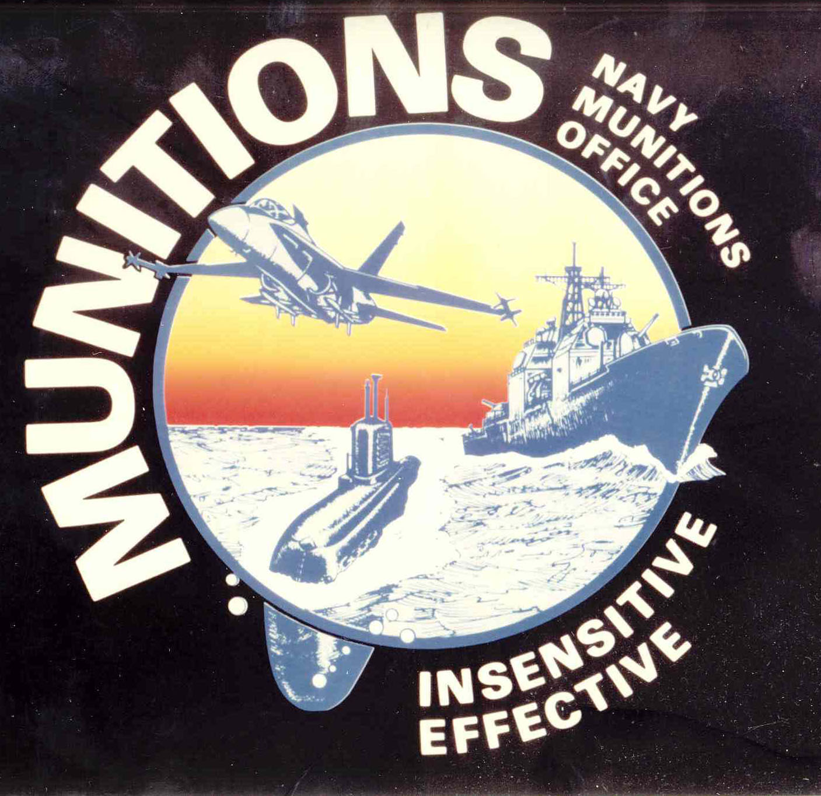
Introduction
Insensitive Munitions Program
  Made Manufacturing Military Explosives Safer
Insensitive Munitions Compounds (IMCs)
  Resists Shock, Heat, and Other Detonations
  But Also Environmental Degradation
Remediation for Mixture of IMCs
http://www.insensitivemunitions.org/wp-content/uploads/2011/06/logo-300x291.png
Notes:
Insensitive Munitions Law and Background
Trying to Figure Out IMC Mixtures

Slide 3
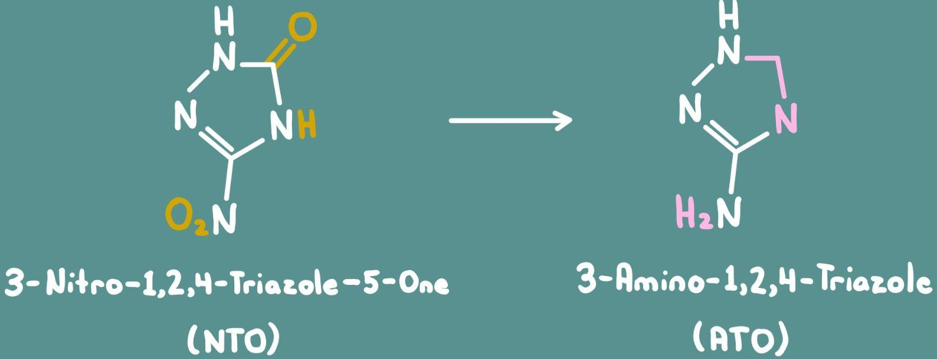
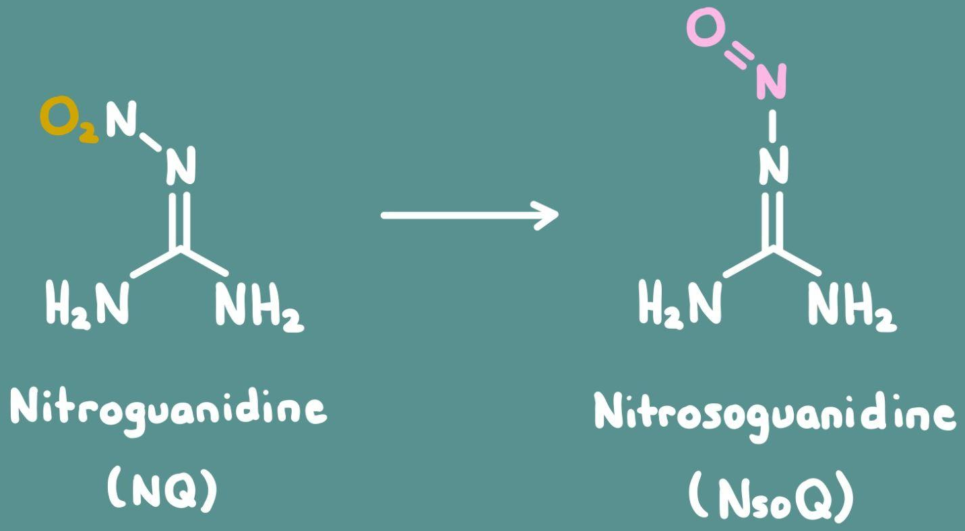
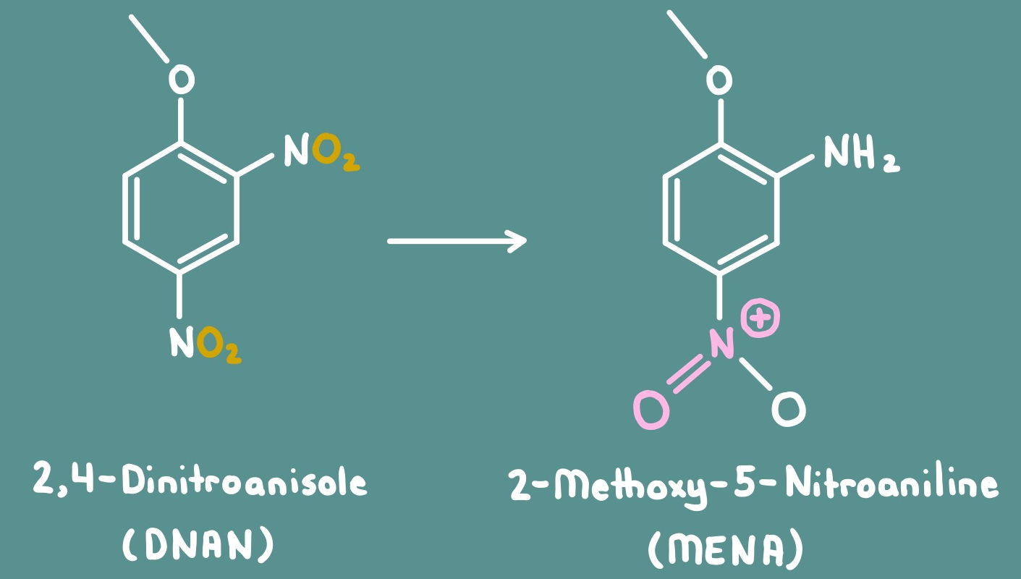
Background
Reducing Agents:
Zero-Valent Iron (ZVI)
Iron Sulfide (FeS)
Notes:
Using HPLC
Preparing Solutions and Monitoring Them
Reduction Reactions

Slide 4
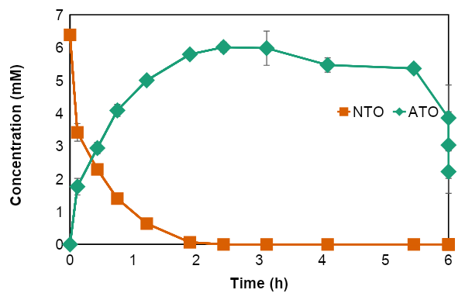
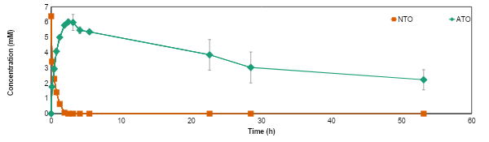
Results (ZVI + NTO)
6.398 mM NTO
35 g ZVI/L

Slide 5
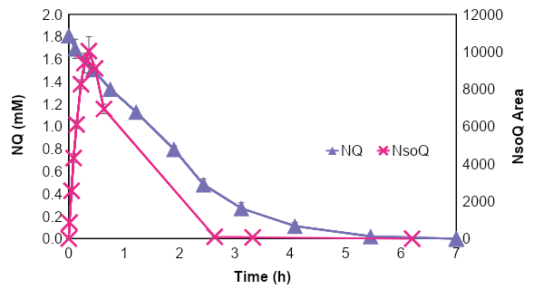
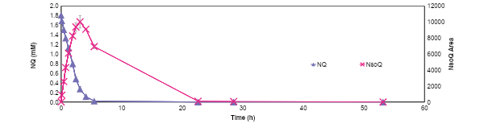
Results (ZVI + NQ)
1.826 mM NQ
35 g ZVI/L

Slide 6
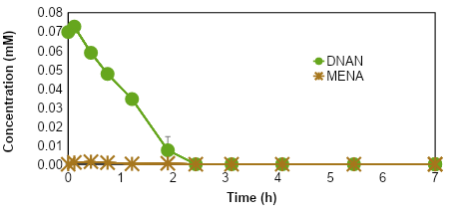
Results (ZVI + DNAN)
0.07 mM DNAN
35 g ZVI/L

Slide 7
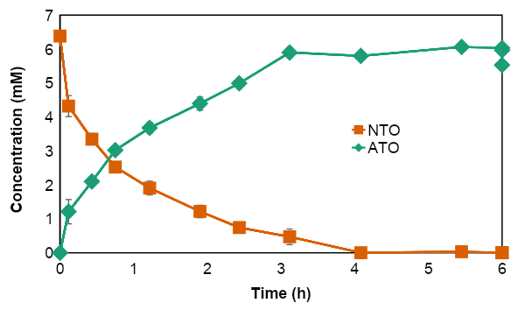
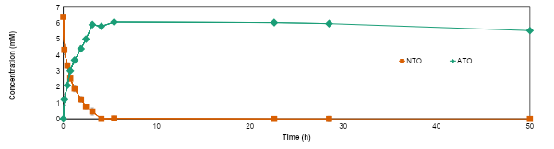
Results (FeS + NTO)
6.398 mM NTO
55 g FeS/L

Slide 8
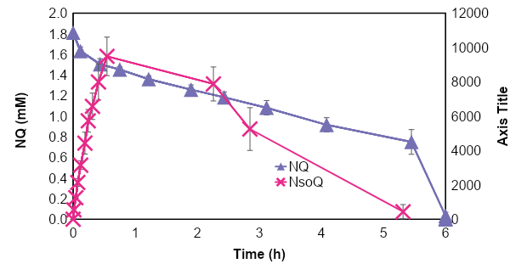
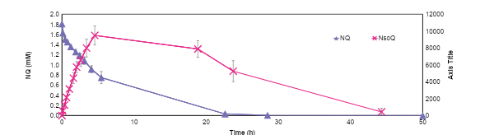
Results (FeS + NQ)
1.826 mM NQ
55 g FeS/L

Slide 9
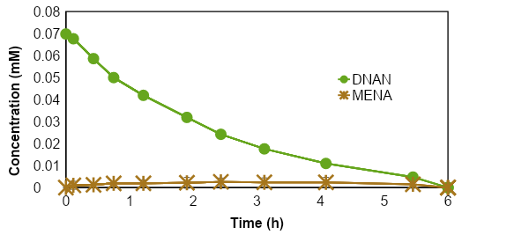
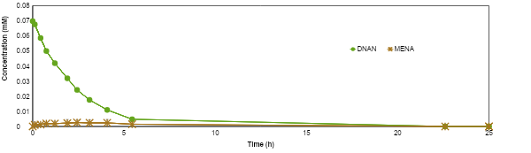
Results (FeS + DNAN)
0.07 mM DNAN
55 g FeS/L

Slide 10
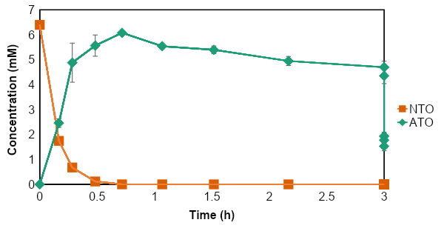
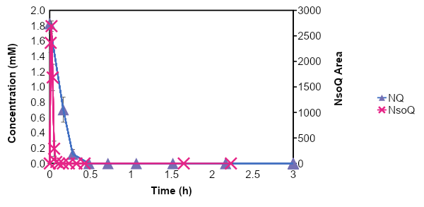
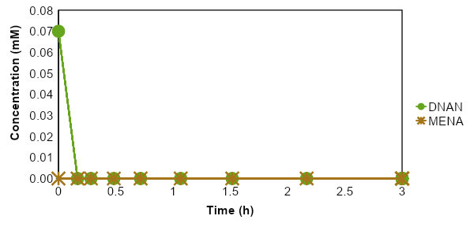
Results (Individual IMCs + ZVI)

Slide 11
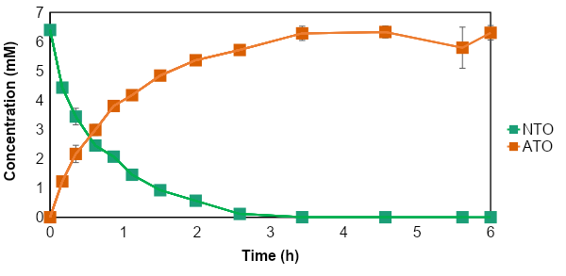
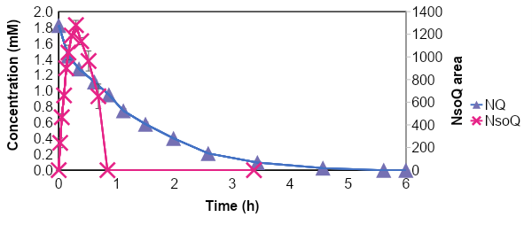
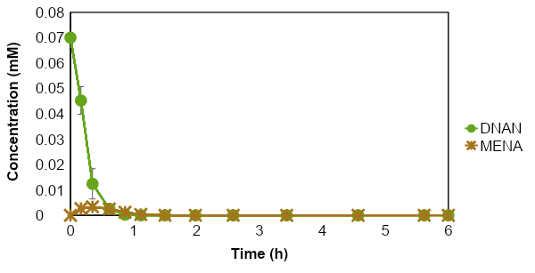
Results (Individual IMCs + FeS)

Slide 12
Conclusions
6.398 mM NTO
0.07 mM DNAN
1.826 mM NQ
Pseudo-First-Order Rate Constant (k₁)
IMCs Mixtures | NTO |  | DNAN |  | NQ
 | k₁ (h⁻¹) | R² | k₁ (h⁻¹) | R² | k₁ (h⁻¹) | R²
ZVI (35 g/L) | 2.33 ± 0.43 | 0.93 – 0.97 | 0.60 ± 0.05 | 0.96 – 0.98 | 0.66 ± 0.07 | 0.95 – 0.97
FeS (55 g/L) | 0.79 ± 0.09 | 0.98 – 0.99 | 0.42 ± 0.04 | 0.99 – 1.00 | 0.15 ± 0.02 | 0.98
Individual Compounds | NTO |  | DNAN |  | NQ
 | k₁ (h⁻¹) | R² | k₁ (h⁻¹) | R² | k₁ (h⁻¹) | R²
ZVI (35 g/L) | 8.52 ± 1.18 | 0.97 – 1.00 | > 20.79* |  | 9.58 ± 1.77 | 0.85 – 0.98
FeS (55 g/L) | 1.41 ± 0.08 | 0.95 – 0.98 | 6.70 ± 1.08 | 0.97 – 0.98 | 0.90 ± 0.09 | 0.98 – 1.00
* Calculated considering the quantification limit for DNAN (2.2 µM)
Notes:
How to Interpret Results

Slide 13
Thank You!
Thank you to the Field-Sierra Research Group, the UArizona Chemical and Environmental Engineering Department, Osmar Menezes, Dr. Sierra Reyes, Kartika Srivastava, and the NASA Space Grant Organizers!

